Slide 1


Easy video maker
Video cutting & merging tool

Slide 2
introduction
Number of video editing related tools available today, but they are containing only English language. They do not offer any other languages. In our project we are going to develop a video cut and merging tool which contains all three languages in our country such as English, Sinhala and Tamil. And it will give easiness to do some specific tasks such as cut and merge videos.

Slide 3

objectives
When our project is fulfilled public can be able to get more benefits. It will contain a good user friendly interface and it will contains easy functionalities for user.
We are mainly focus on two main operations.
If anyone wants to cut and merge they can do it according to the buttons.
We hope that when this project fulfilled it will make user happy.

Slide 4


Features
Video cutting
Video merging
Video cut is the process of removing the head and/or the tail of the video clip.
Video cut also known as trim, split and splice.
Video Merge is the process of combining or joining multiple video files into a single video file.

Slide 5
process
Install
Open
Select Language
If select English as language
Cut or Merge
Select a option
If select cut option
Add a video
Enter start second that you want to start cut
Press CUT button
Enter how many seconds that you want
Save the cutted video
Select saving folder & give a new name
If select merge option
Add the videos
Press Save
Save the merged video

Slide 6
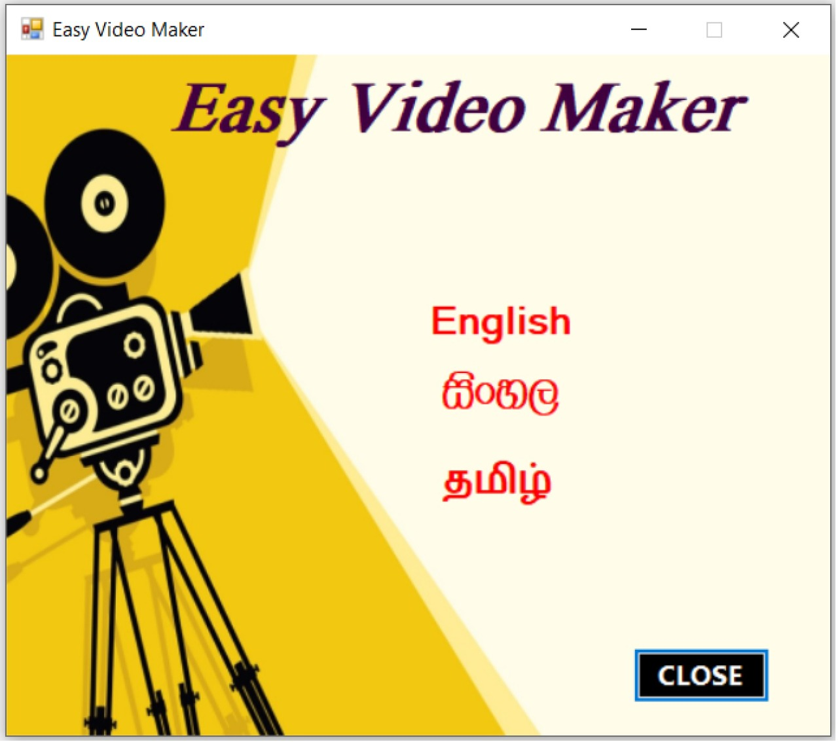
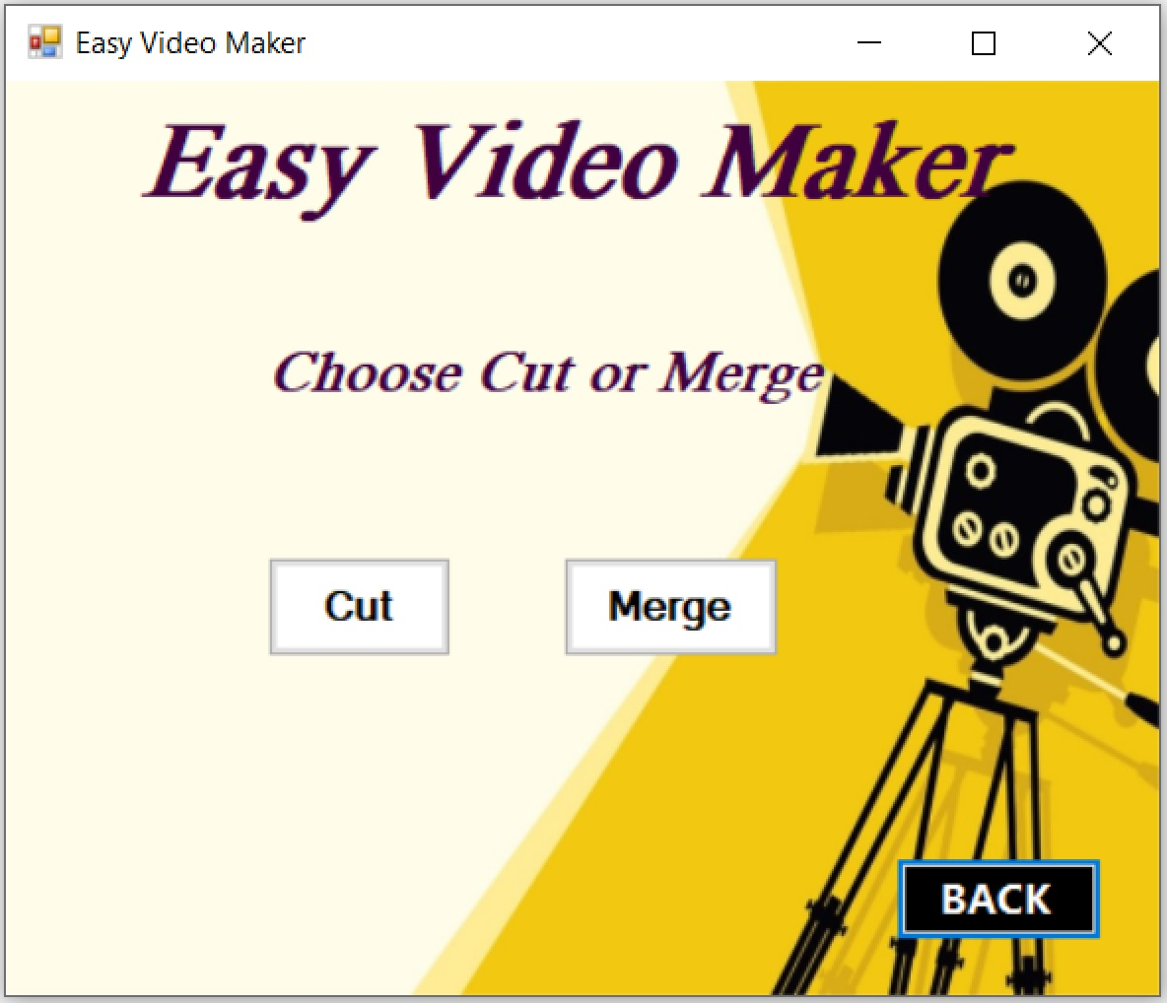
Ui designs
Selecting language window
Selecting option window

Slide 7
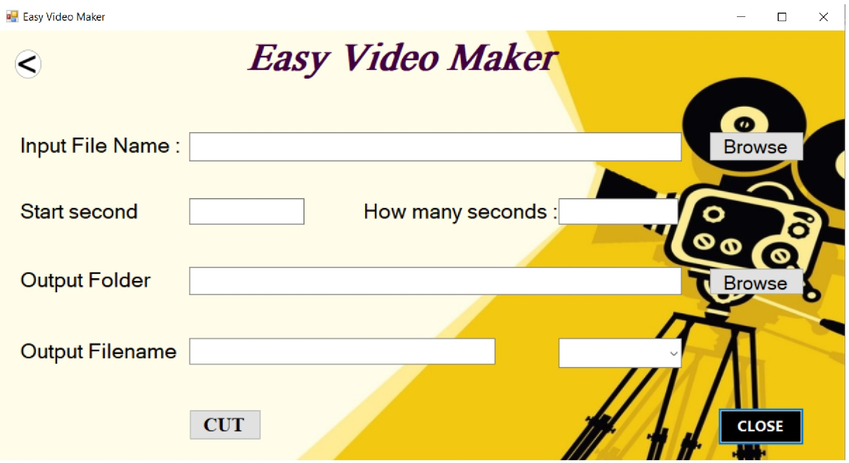
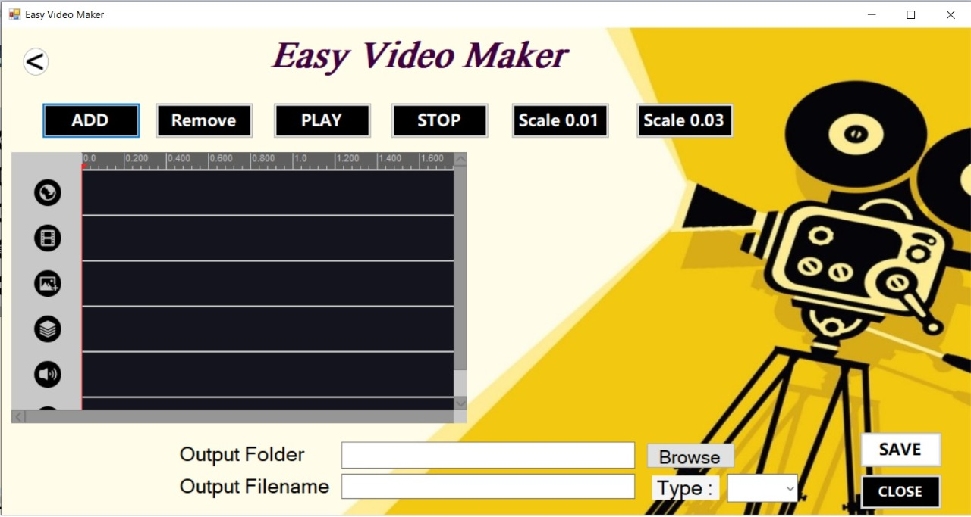
Video cutting window
Video merging window

Slide 8

Members – Team 07
2017/ICT/02 – R.M.S.S.P. Balasooriya
2017/ICT/32 – G.M.S. Kulathunga
2017/ICT/45 – I.A.T.S. Premathilaka
2017/ICT/77 – V. Thivaharan
2017/ICT/85 – V. Gejaani

Slide 9
Thank you !!!

